Slide 1



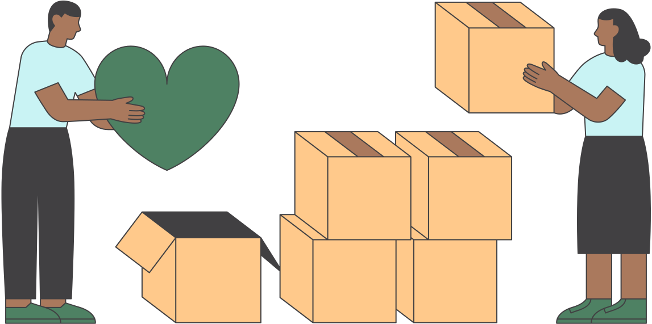


EMPOWERING INDIVIDUALS AND FAMILIES THROUGH HOUSING CHARITY
“REPAIRING HOMES, REVITALIZING COMMUNITIES, REBUILDING LIVES.”

Slide 2
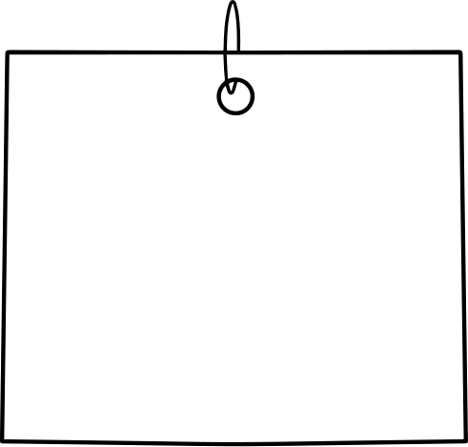



OUR GROUP
Brady Pinter
Jayden Cruz
Cindy Nguyen
Evelyn Na
Colin Onevathana
Pratyusha Shanker

Slide 3
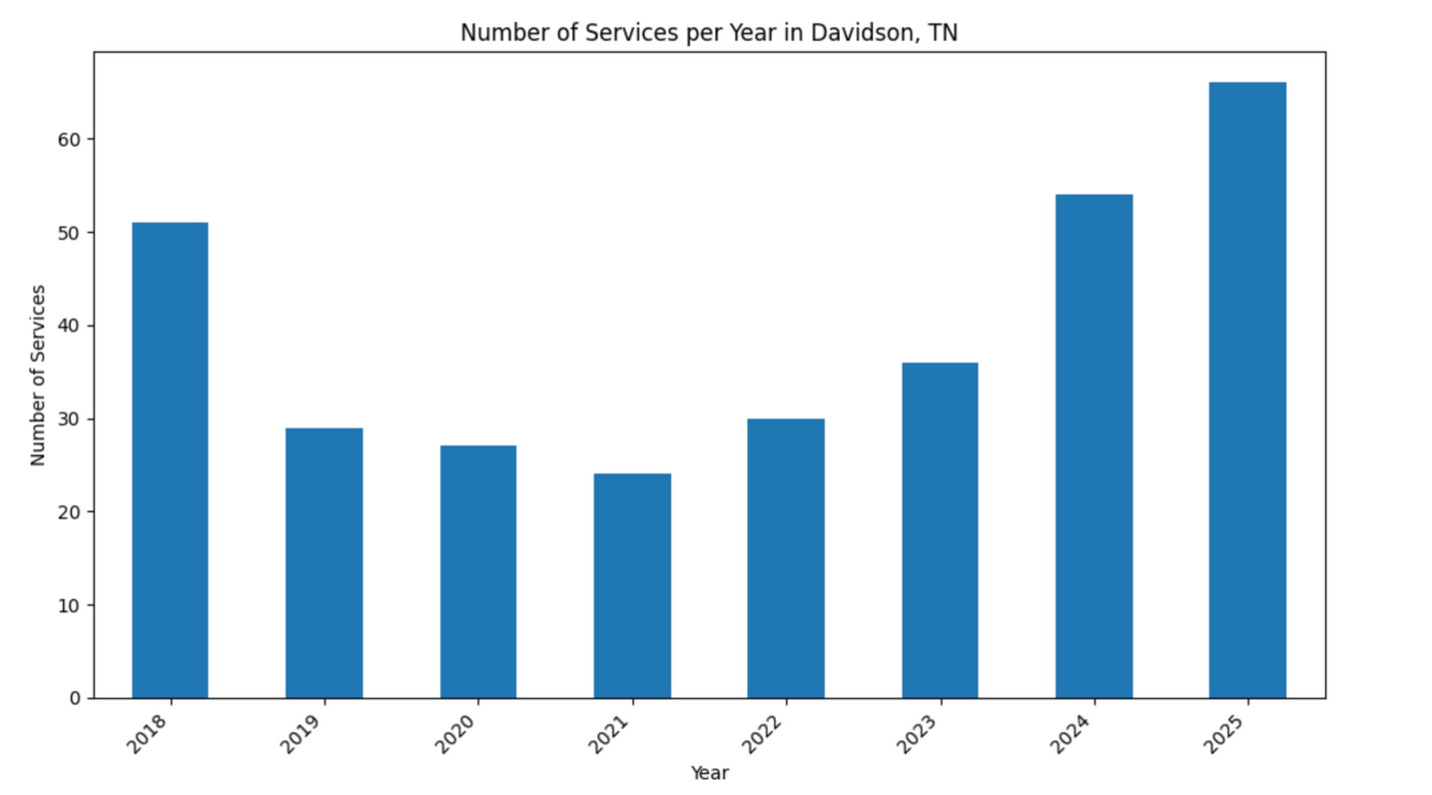
LOOKING FROM ABOVE
317
individual repairs
since 2018
Notes:
jayden

Slide 4

THE CHALLENGE
How can we use data-driven insights to prove that community housing repair investments genuinely improve lives and strengthen neighborhoods?
Many nonprofits are in need of quantitative, data-backed evidence to support and validate their impact stories.
Our goal: combine census data, service applications, and housing data to demonstrate measurable community impact.

Slide 5
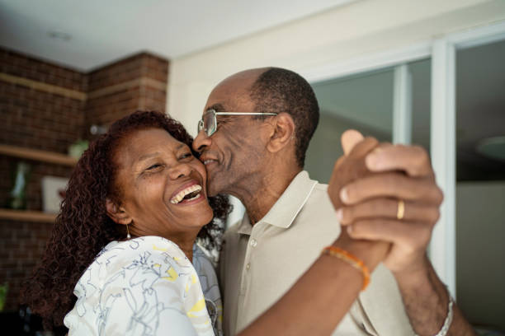
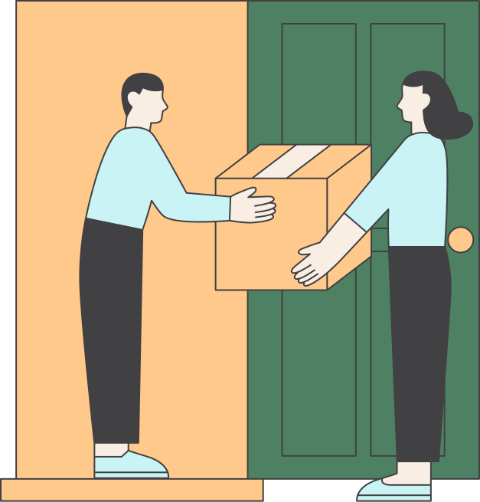
Fighting Gentrification
Gentrification is a huge issue that has historically affected and continues to effect black communities in the Nashville area.
Gentrification
breaks up social support networks that have taken years to build
makes homeownership less accessible than it already is for Black Americans
makes it even harder for historically disadvantaged communities to build generational wealth
Home-repair assistance programs, such as Rebuilding Together, play a critical force in helping to prevent gentrification. These programs help preserve affordable housing, stabilize neighborhoods, and empower historically marginalized communities.
COMMUNITY
CONTEXT

Slide 6
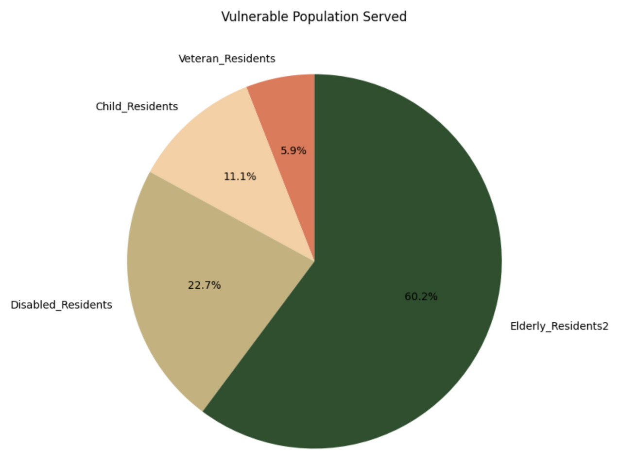
COMMUNITY
CONTEXT
Notes:
This helps you show who is being impacted.
You can demonstrate your focus on vulnerable populations, such as, "60% of our investment has gone to households with elderly , etc.

Slide 7

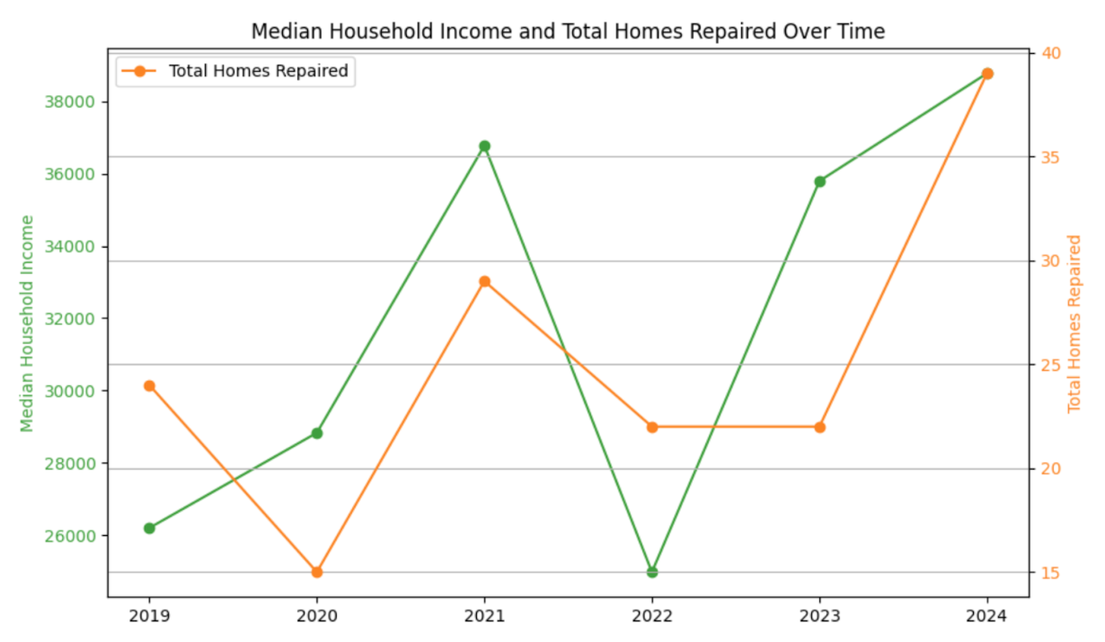

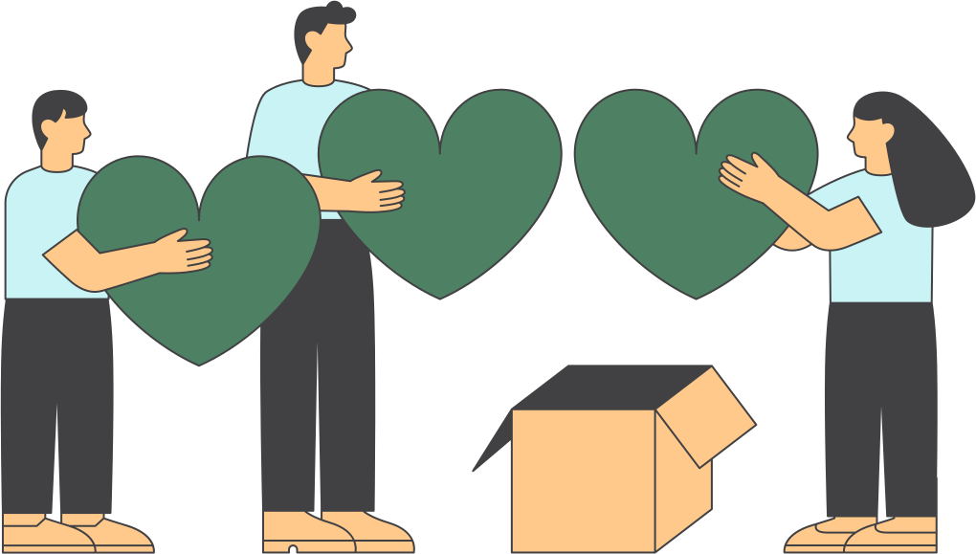
STORY OF IMPACT
IMPACT PER DOLLAR
LOW COST HIGH IMPACT HOME REPAIRS
DISASTER RELIEF
151 homes repaired from 2019-2024
Notes:
Talk about the impact

Slide 8
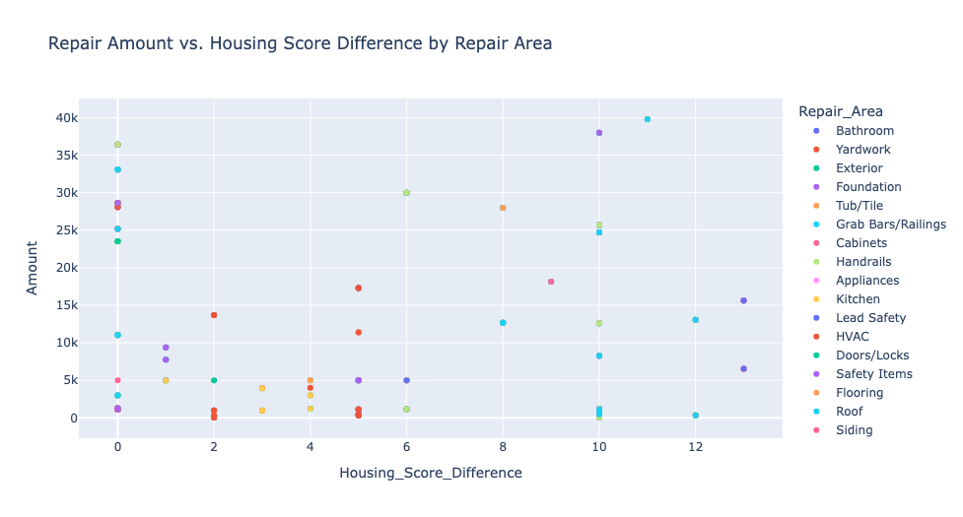
REPAIRS THAT MAKE A DIFFERENCE
FOCUS ON QUICK WINS
HOUSING SCORE DIFFERENCE

Slide 9
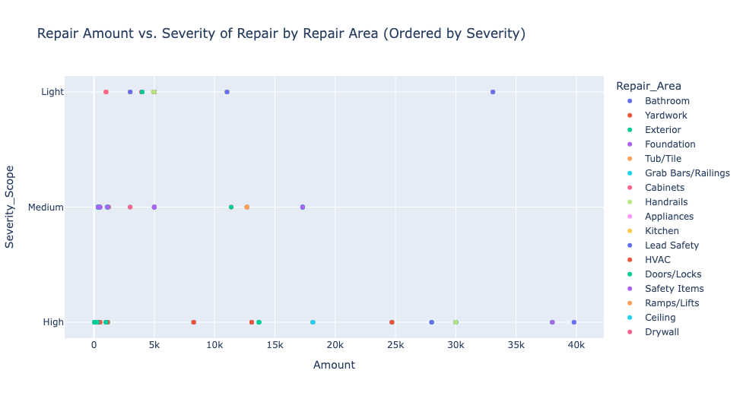
FOCUS ON THOSE IN NEED
LOOKING AT SEVERITY
HIGH SEVERITY, LOW COST
Notes:
Talk about the impact

Slide 10
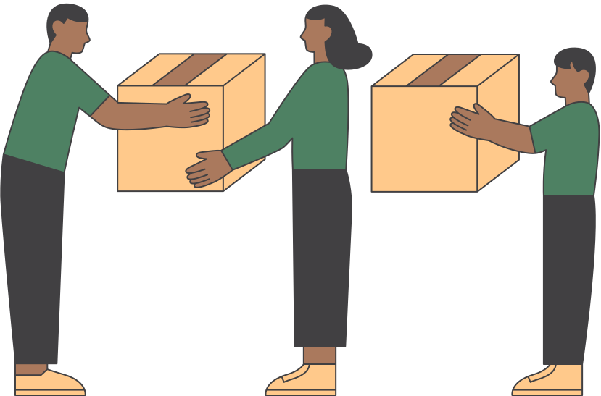
FINAL TAKEAWAY
The need for repairs are rising annually rapidly
Home repairs help to empower historically disadvantaged communities
Repairs can be prioritized with repair costs, housing ratings,
and severity

Slide 11
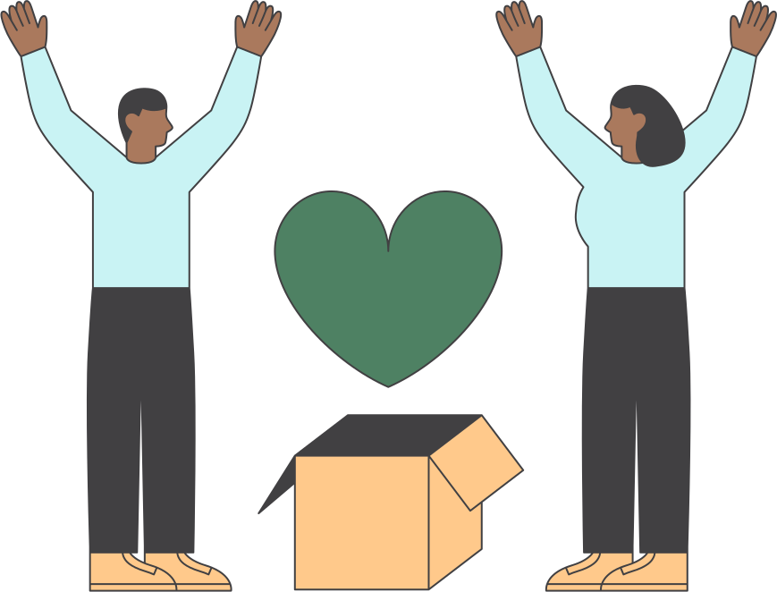
THANK
YOU
“REPAIRING HOMES, REVITALIZING COMMUNITIES, REBUILDING LIVES.”

